Slide 1

TEAM 13
INVESTMENT PORTFOLIO
DECEMBER 15, 2022

Slide 2




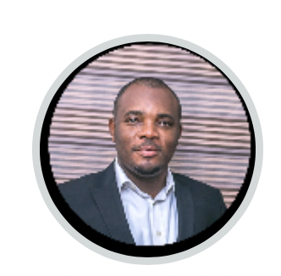
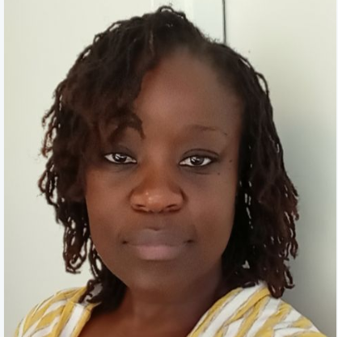
Rhea Kapoor
Marc Zürn
Tebatso Nyarambi
Omoikhefe Leckey-Jeffery
Aienloshan

Slide 3
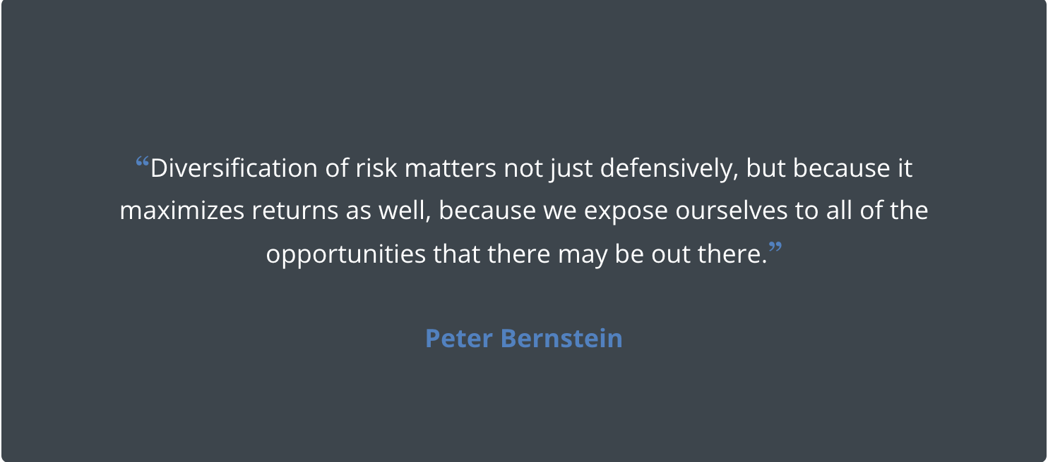

Slide 4
Our top four clients

Slide 5
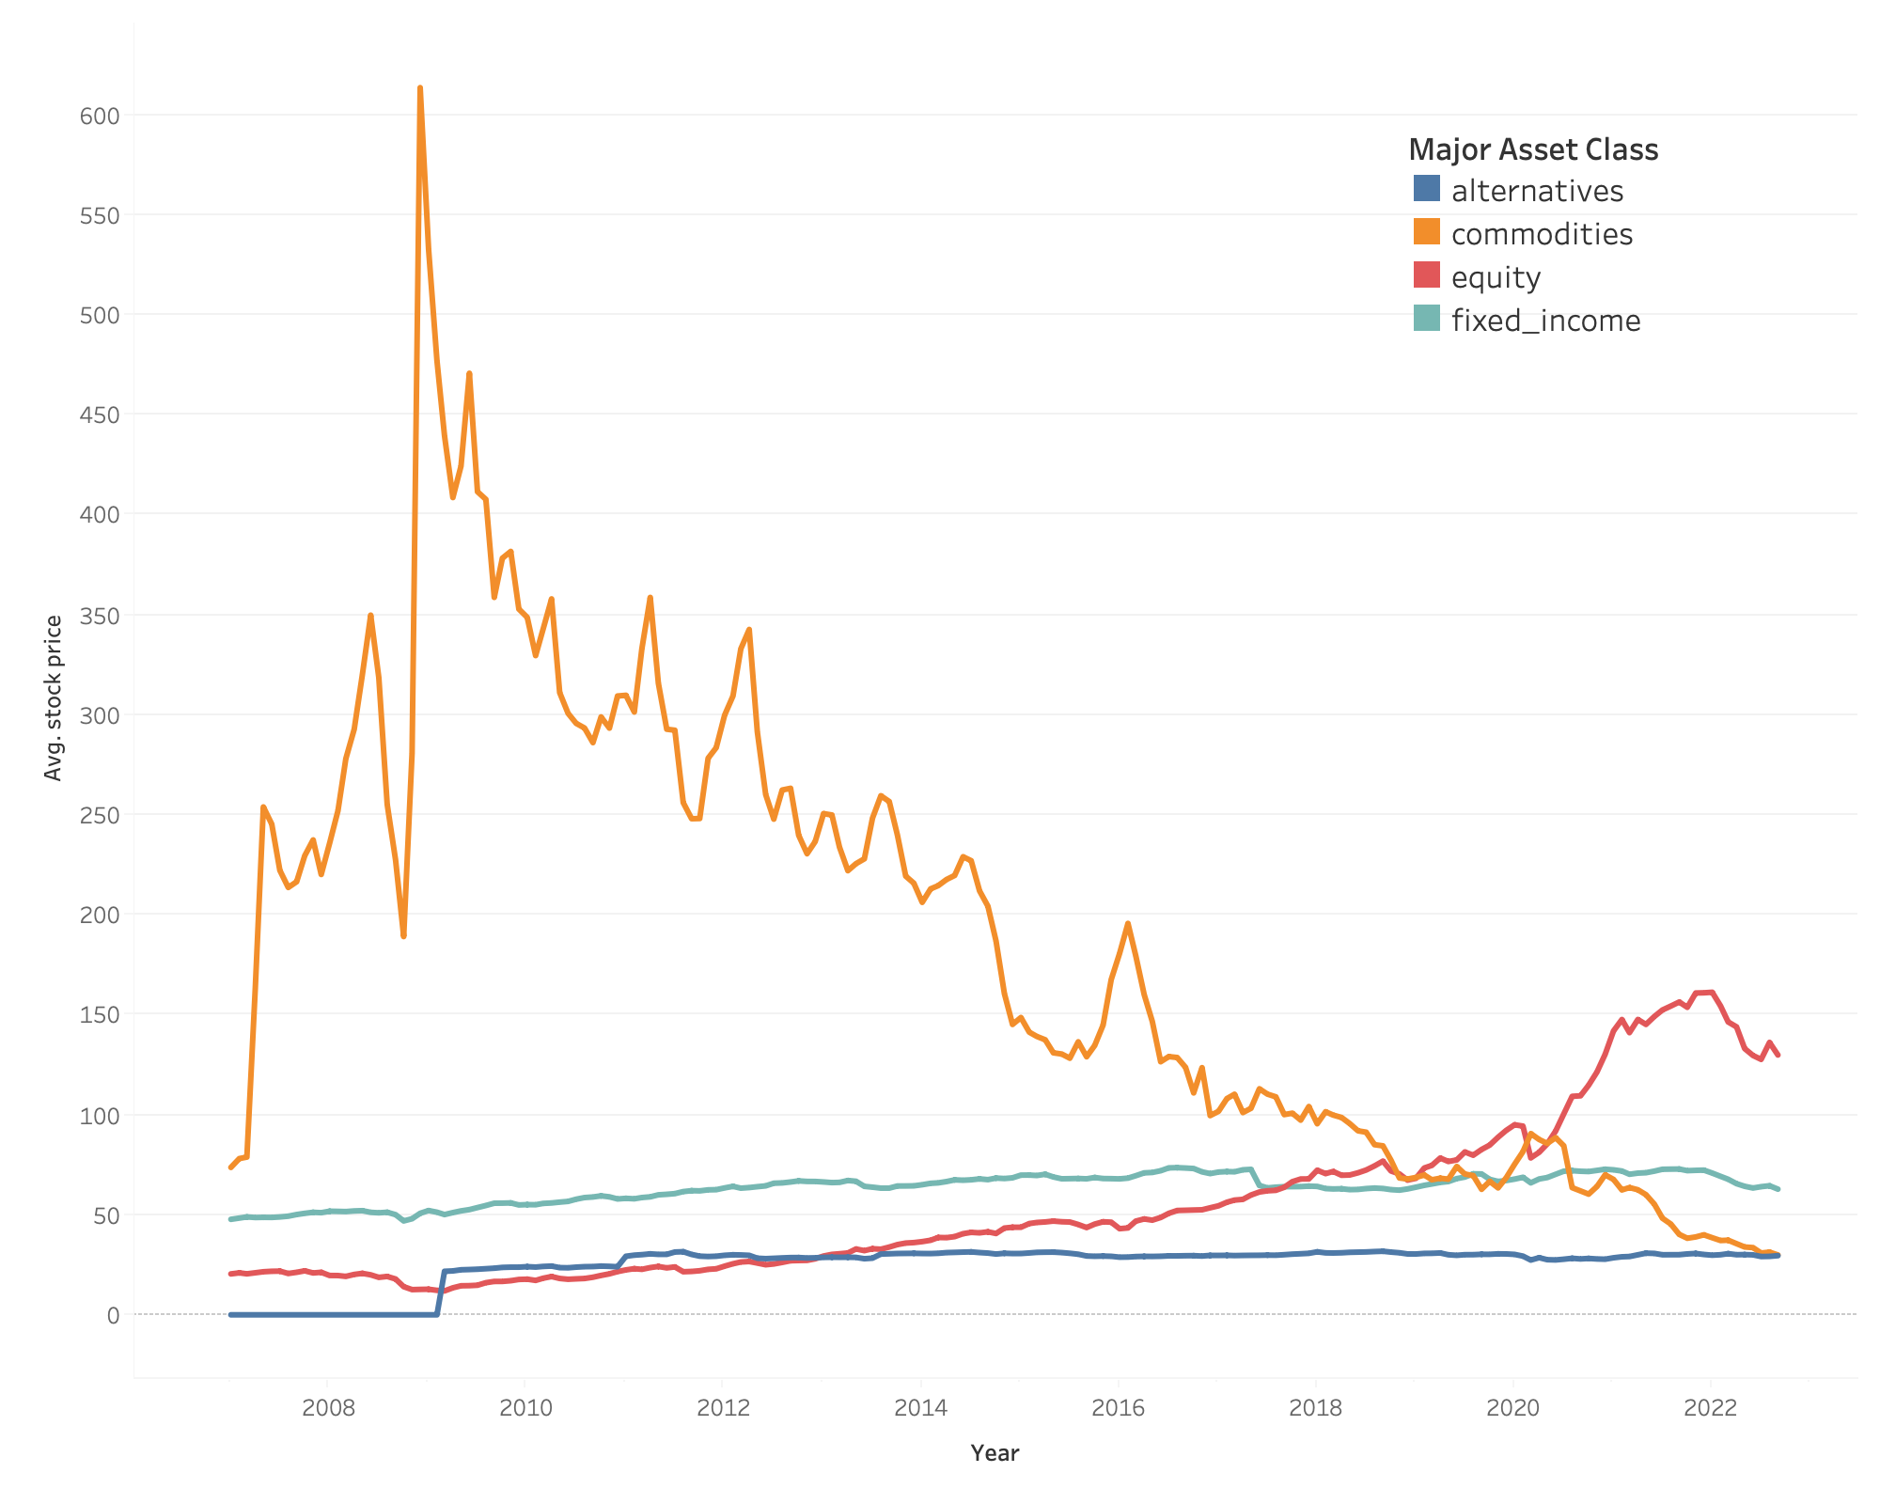

Performance of Major Asset classes over time

Slide 6





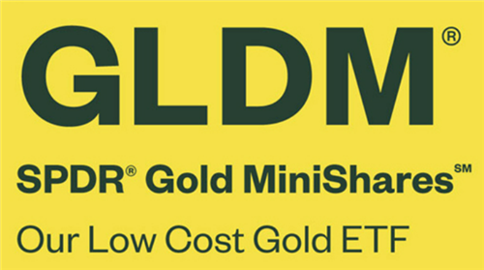
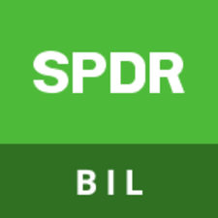


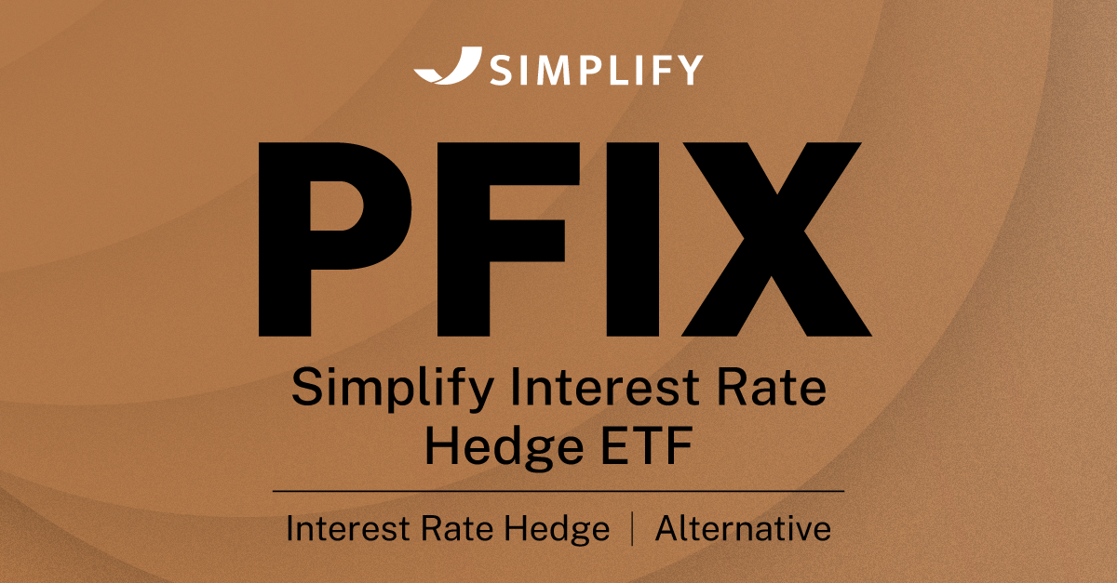


Major current holdings for Georgi Kodinov
EQUITY
COMMODITIES
FIXED INCOME
ALTERNATIVES

Slide 7
36-month ROI for Georgi Kodinov’s portfolio

Slide 8
ROI Overall vs Kodinov

Slide 9
How does the Risk influence our ROI?

Slide 10


How to rebalance our Portfolio? How to diversify our risk?

Slide 11
Rebalancing the Portfolio

Slide 12

Correlations per major asset class (Equity vs Alternatives and Fixed Income)

Slide 13



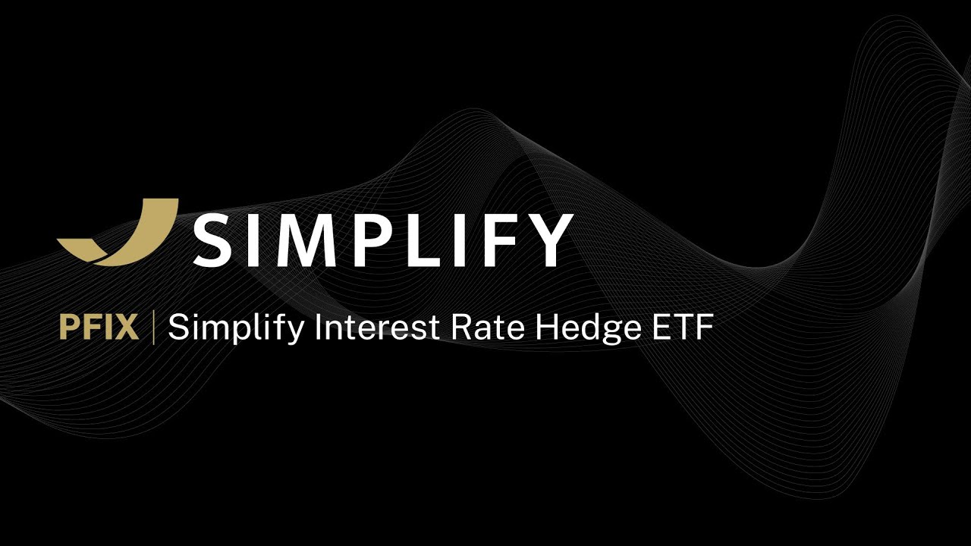










Rebalancing
Equity - 1.7 M
Alternatives + 1.3MM
Fixed Income + 0.4 M

Slide 14
Rebalancing the Portfolio
0.57
RISK
0.31

Slide 15


Slide 16
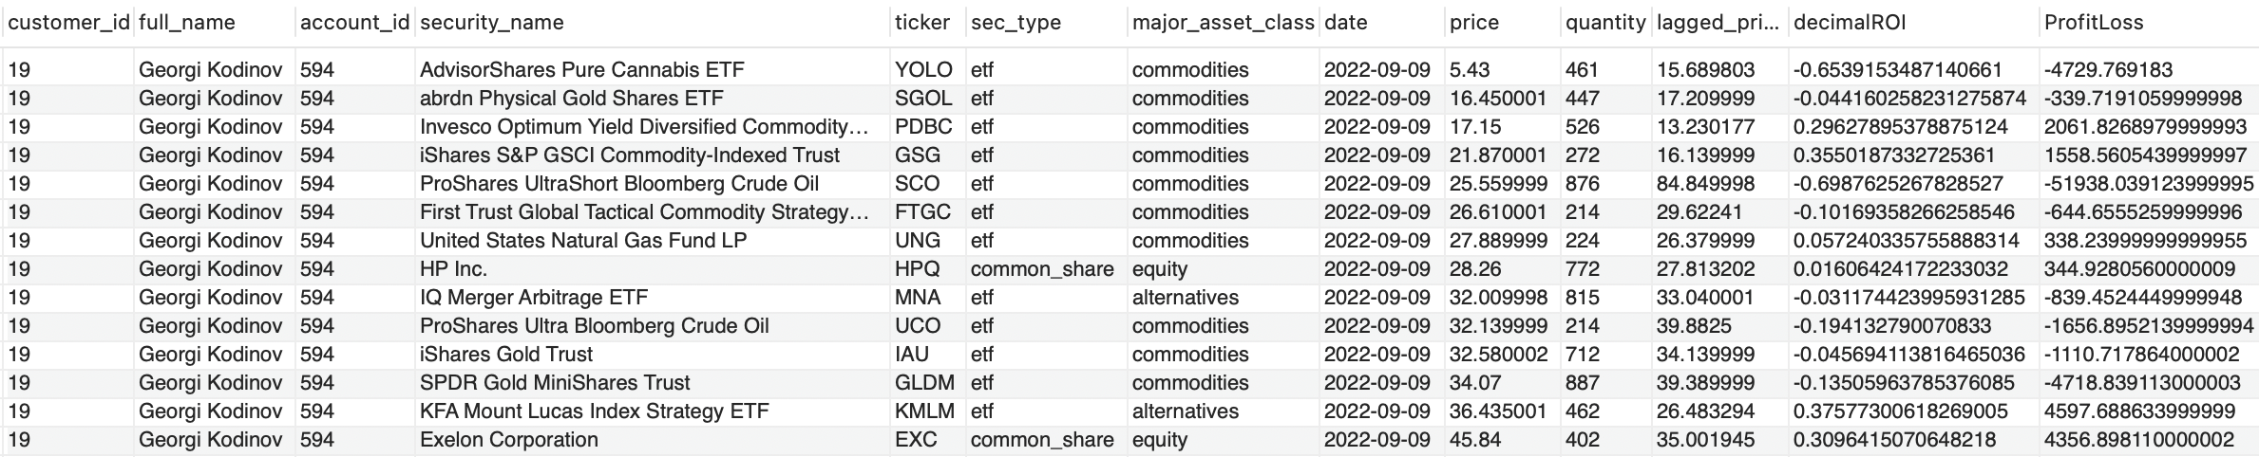
Appendix
-- Question 1 - What is the most recent 12M**, 18M, 24M (months) return for each of the securities?

Slide 17
Appendix
Finding correlation between average returns of different asset classes.
The formula for Pearson's correlation coefficient is covariance of two variables divided by the product of their standard deviations

Slide 18
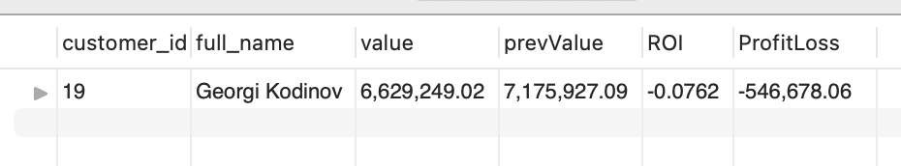
Appendix
-- Question 1 - What is the most recent 12M**, 18M, 24M (months) return for each of the entire Portfolio?

Slide 19
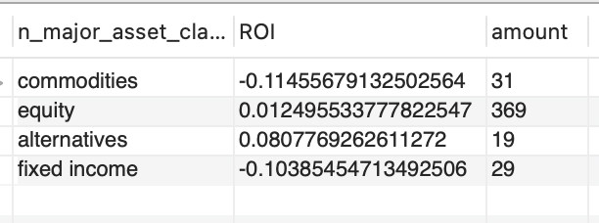
Appendix
-- What is the ROI on Major Asset Classes Overall

Slide 20
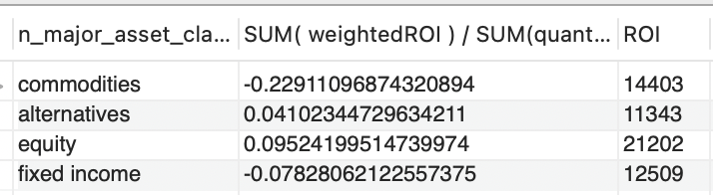
Appendix
-- What is the ROI on Major Asset Classes for our Portfolio
-- Calculate the weighted ROI for our portfolio based on the quantity

Slide 21
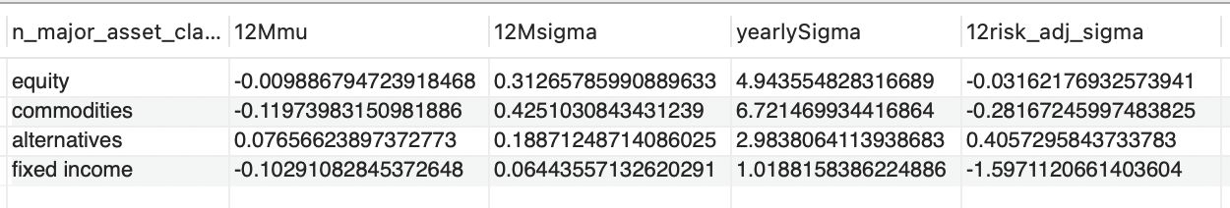
Appendix
-- What is the RISK on Major Asset Classes Overall

Slide 22
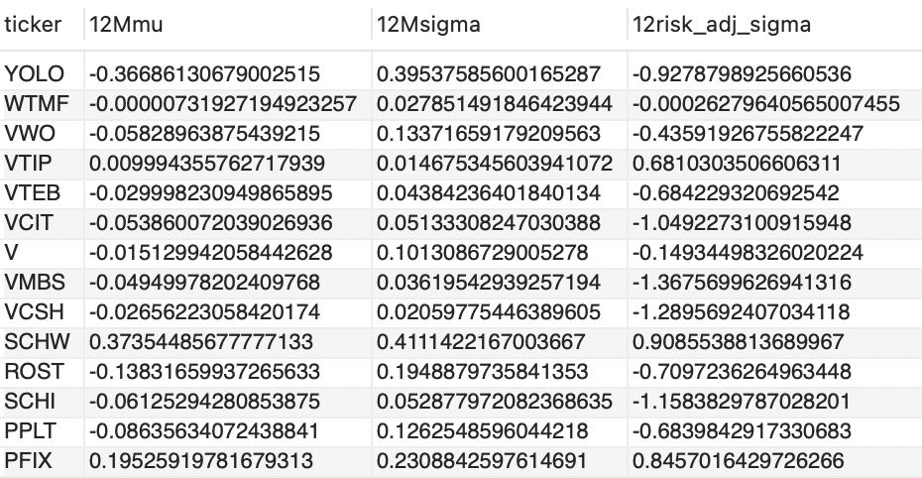
Appendix
-- What is the RISK on all Asset on our Portfolio

Slide 23
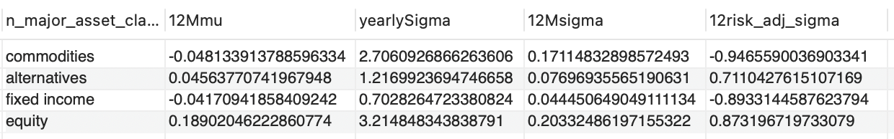
Appendix
-- What is the RISK on Major Asset Classes on our Portfolio

Slide 24
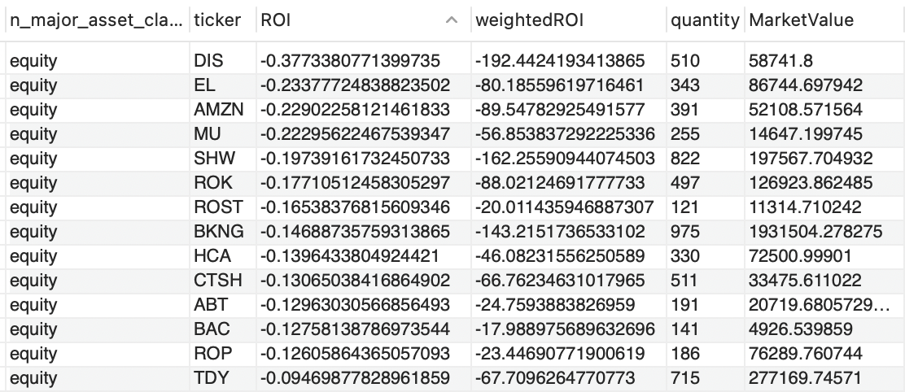
Appendix
-- What to sell in our Portfolio

Slide 25
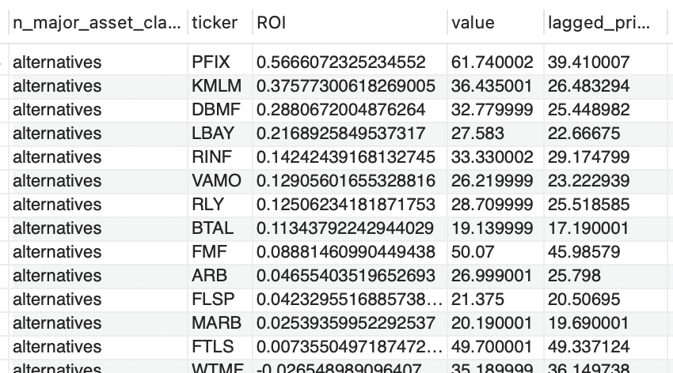
Appendix
-- What to buy for our Portfolio

Slide 26
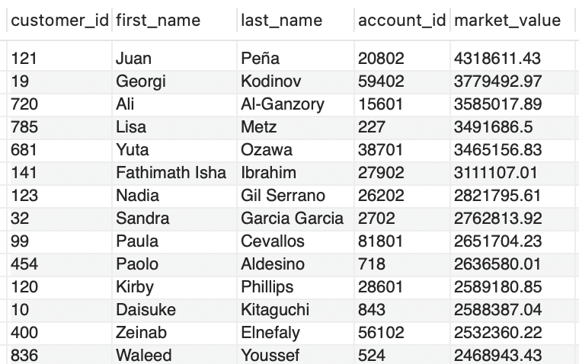
Appendix
-- Picking the sample: Selecting Top 4 clients with highest market value

Slide 27
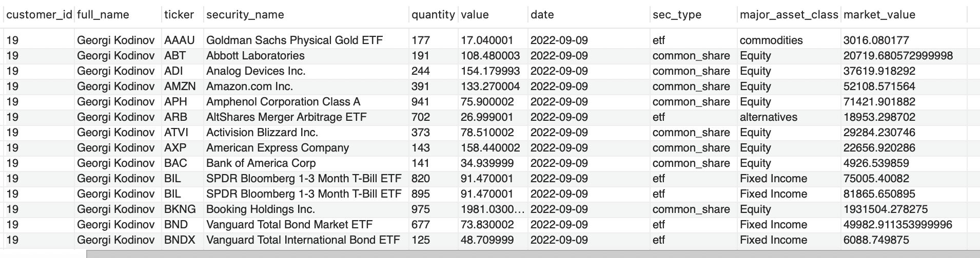
Appendix
-- Evaluating Georgi's current portfolio

